Slide 1
Quick-Merge Sorting Parallelization
With Solar Vehicle Applications
Logan Richardson & Isaac Allen

Slide 2
Description of Project
Parallelized quickSort using OpenMP
Goals:
Practice parallel programming
Build a useful tool for Team Sunergy
Run Procedure
Scan dataset into data structure from comma separated value file
Sort dataset with sequential quicksort and/or sequential merge sort
Sort data with parallelized quicksort and/or parallelized merge sort
Report speedup

Slide 3
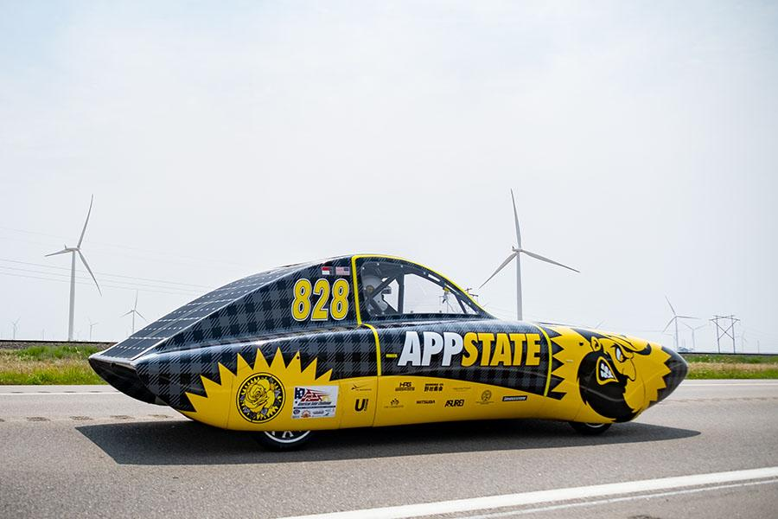
Team Sunergy:
Solar Vehicle Applications
Optimize data sorting
Data driven strategy analysis
Advance Sustain. Tech

Slide 4
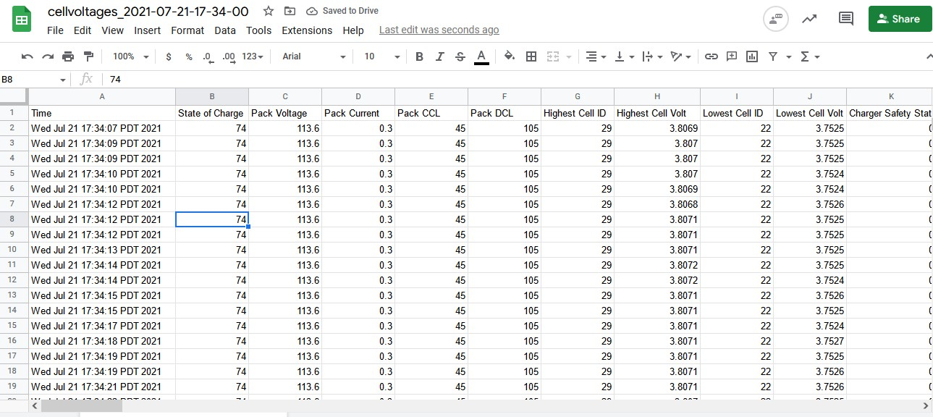
Dataset
Team Sunergy
Battery Management System live race data
30 unique Variables
Over 78,000 Data points generated in 7 hours.

Slide 5
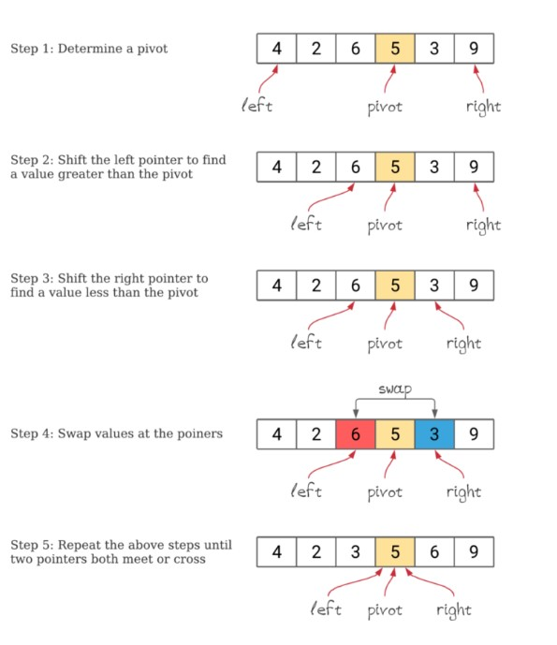
Sequential Quicksort Algorithm
Key Aspects
Left / Right Pointer
Choose pivot
L & R move inward
Swap numbers around pivot
Divide & conquer strategy
Source: www.baeldung.com/cs/quicksort-vs-heapsort

Slide 6
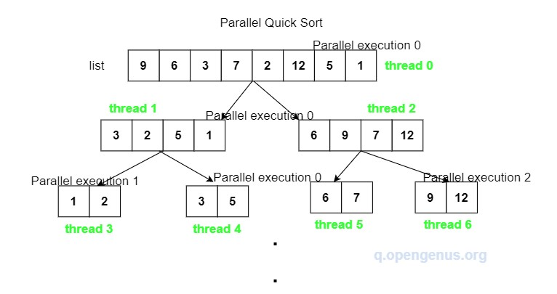
Parallelized Quicksort Algorithm
Key Aspect
Recursive partitioning divided among threads up to 2* thread Count
Source: https://iq.opengenus.org/parallel-quicksort/

Slide 7
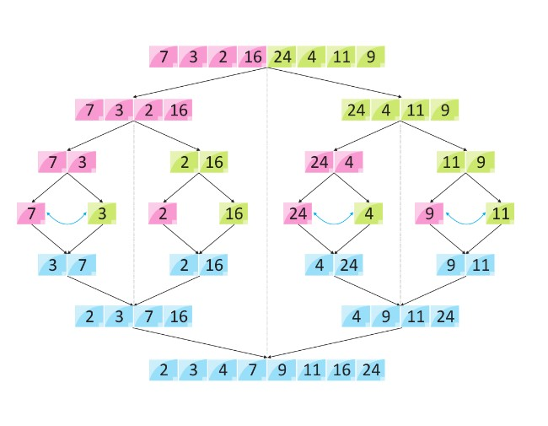
Sequential Merge Sort Algorithm
Key Aspects
Divides data until single element reached
Then “merges” together
Divide & conquer strategy
Source: https://linuxhint.com/merge-sort-python/

Slide 8
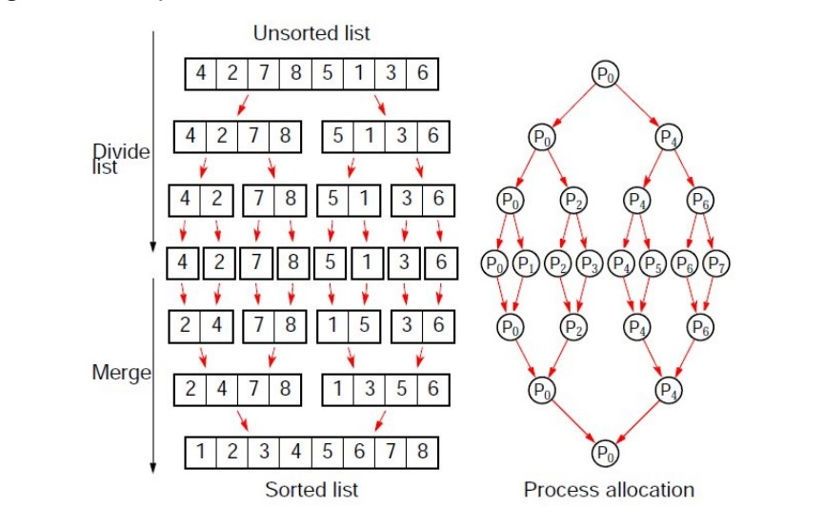
Parallelized Merge Sort Algorithm
Key Aspects
Recursively divides sequences amongst threads
Main thread in charge of merging
Source: https://www.dcc.fc.up.pt/~ricroc/aulas/1516/cp/apontamentos/slides_sorting.pdf

Slide 9
Quicksort vs. Merge Sort
Quicksort
Internal Alg.
Efficiency dependent on pivot points
Less effective on large datasets
Merge Sort
External Alg.
Uses aux. arrays (more memory)
Works well on large datasets

Slide 10
Speedups (Average of 5 Runs / 10K data Size)
# Threads (Y) | Merge Sort (Rose Data) -n 10k -t Y -m | Quicksort (Rose Data) -n 10k -t Y -q
2 | 1.524744 | 1.214641
8 | 1.833836 | 2.155357
16 | 1.580675 | 1.846779
27 | 1.593436 | 1.233407
32 | 1.225889 | 1.159587
48 | 0.459724 | 0.281805

Slide 11
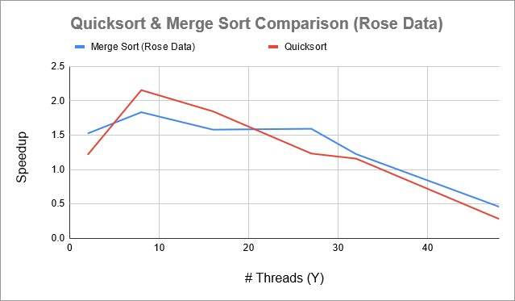
Speedups (Average of 5 Runs / 10K data Size)

Slide 12
Challenges we faced
GPU Quicksort
Inaccessible documentation / UML
Time Constraints
Speedups >> Slowdowns >> WE FIXED IT!

Slide 13
Future Ideas
Features: Choose sort variable, choose pivot
Graphical user interface / Polished app
Implementing GPU Quicksort
Requests from Sunergy team members
Imp. bash script to take avg speedup/100 runs

Slide 14
Sources
Websites
https://data.world/datasets/solar
https://stackoverflow.com/questions/1120140/how-can-i-read-and-parse-csv-files-in-c
www.baeldung.com/cs/quicksort-vs-heapsort
Papers / Books
https://solarcar.mst.edu/wp-content/uploads/sites/14/2019/10/Data-Collection-and-Analysis-Techniques-for-Solar-Car-Telemetry-Data.pdf
https://www.lrde.epita.fr/~bleton/doc/parallel-depth-first-search.pdf
Quicksort: an improved GPU-based implementation of quicksort by Daniel Cederman & Philippas Tsigas
Parallel Programming, Concepts and Practice, textbook by Bertil Schmidt, Jorge Gonazales-Dominguez, Christian Hundt, & Moritz Schlarb

Slide 15
Sources
Images
“Rose” - Solar Car, Team Sunergy https://today.appstate.edu/2021/08/12/sunergy-wins
Team Sunergy Dataset Team Sunergy Data Archives
Sequential Quicksort www.baeldung.com/cs/quicksort-vs-heapsort
Parallelized Quicksort https://iq.opengenus.org/parallel-quicksort
Sequential Merge Sort https://linuxhint.com/merge-sort-python
Parallelized Merge Sort https://www.dcc.fc.up.pt/~ricroc/aulas/1516/cp/apontamentos/slides_sorting.pdf

